Slide 1


Slide 2
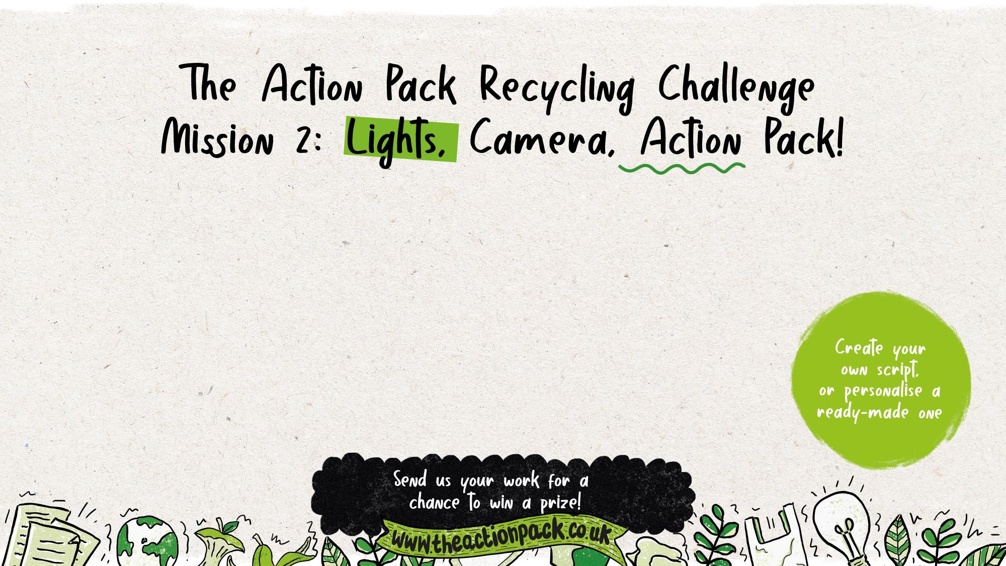
Create a film or show to help others in your community
to recycle more, and recycle better.
Curriculum links: PSHE, Art, English
Time required: 60-120 minutes

Slide 3
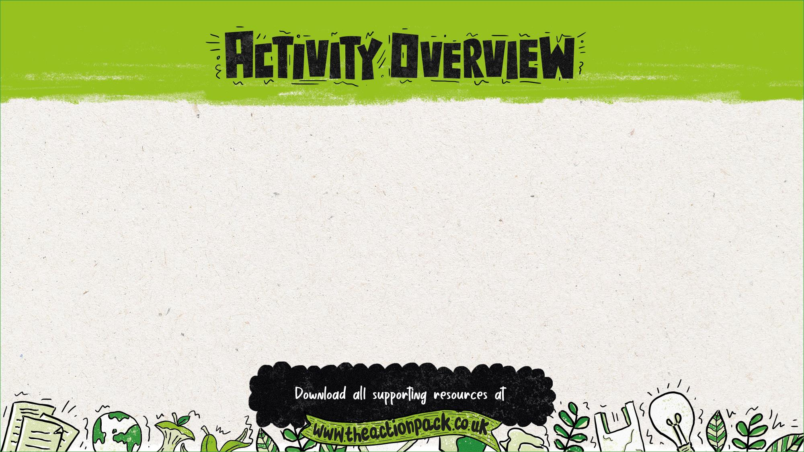
In this session pupils will create and build an animal puppet out of recyclable materials, learn about the key elements of script writing and, either personalising a template script or creating their own, make a film or play featuring their characters to inspire others to recycle.
Where to use this activity
This activity can be completed
in class
as homework
at after-school clubs
with an eco committee or school council
in an out-of-school club.
How to use this presentation
The teachers’ notes slides at the start of this presentation are hidden, so they won’t appear in presentation mode.
There is additional information for teachers in the slide notes for each of the pupil slides (9-27).
Preparation
The activities in this presentation assume a good baseline knowledge of recycling from pupils. For a comprehensive introduction to recycling check out lesson one, Join the Action Pack presentation.
Follow up
Optional: Create a poster to encourage your community to recycle more, and recycle better, using the Action-packed Poster presentation.
All resources can be found at www.theactionpack.co.uk

Slide 4
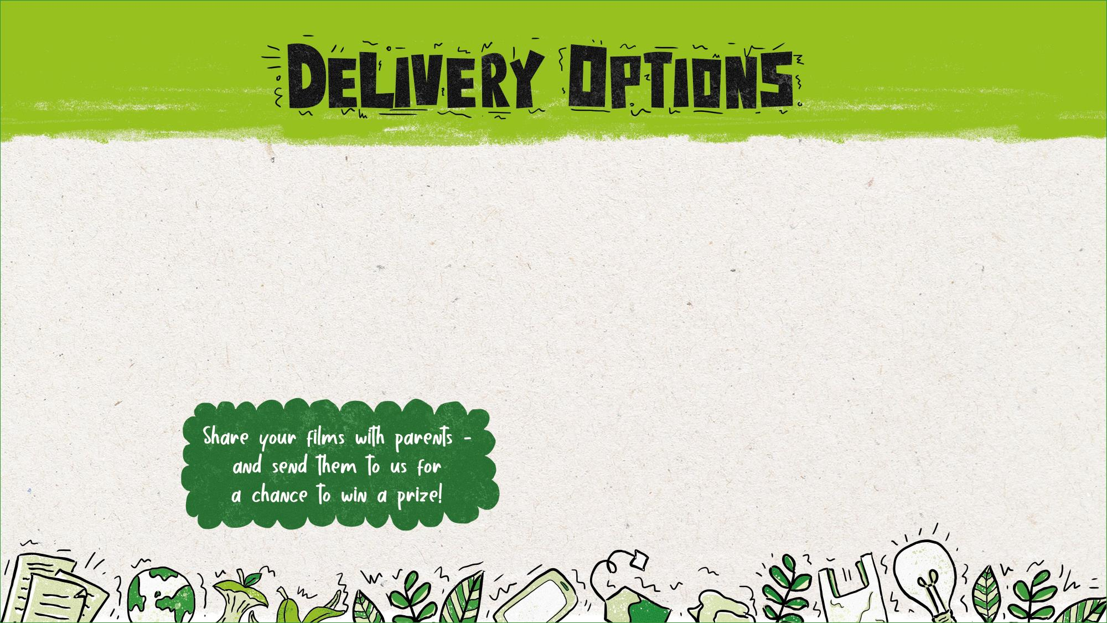
Option A (60 minutes)
Watch the video to introduce the activity (5 mins)
Use the presentation to discuss materials and character ideas as a class (10 mins)
Ask pupils to design and make their character using recyclable materials (15–20 mins)
Groups rehearse/film a pre-adapted version of the Eco Show Example Script and their own characters (15–20 mins).
Summarise class/watch and photograph selected performances (5 mins)
Option B (120 minutes)
Session one
Use the starter activity and video to introduce the activity (5–10 mins)
Use the presentation discuss materials character ideas as a class (10 mins)
Ask pupils to use the ‘My character’ activity sheet to think more about their character (10 mins)
Pupils build their characters using recyclable materials (20–25 mins).
Summarise class and ask selected pupils to present their characters to the class (5–10 mins).
Session two
Run an active brainstorm to help your class think about the audience for their Eco Shows/discuss audience as a class (10 mins).
Discuss the key elements of script writing and persuasive messaging as a class (5 mins)
Ask pupils to work in small groups (of at least three) to complete the Eco Show Script Planner activity sheet (10 mins)
Challenge groups to create/adapt their own script using their completed planner, Top Tips for Writing a Script information sheet, the Eco Show Example Script and/or complete Eco Show Storyboard activity sheet. (15–20 mins)
Ask pupils to rehearse and film their shows (15–20 mins)
Summarise class and watch selected performances (5 mins)

Slide 5

Why use this activity?
This lesson was created in partnership with teachers to make sure that it links to the curriculum and enhances learning.
The lesson helps to inform, inspire and empower children to get their voice heard and bring about change.
It also encourages pupils to become active citizens who make a positive contribution to society, helping to fulfil the requirements of Ofsted and promote British values.
This PowerPoint could form part of your audit and action plan for the UNICEF Rights Respecting Schools Award, or as part of your Eco-Schools Award action plan.
It includes flexible resources that can be used with small groups, a whole class, the entire school or the School Council.
Use this lesson to get people in your local area recycling more, helping to conserve our planet’s precious resources.
By submitting the work your pupils produce in this lesson, you’ll be in with a chance to win great prizes.
Who produced this activity?
Recycle Now is an established brand that campaigns to encourage and motivate citizens to recycle more things, more often, from all around the home. We use our evidence, interventions and ground-breaking behaviour change theory to motivate citizens to recycle.
For more information about Recycle Now visit: www.recyclenow.com
You can also help to encourage recycling by adding the Recycling Locator to your website – email: partnerenquiries@wrap.org.uk

Slide 6

English
Years 1 to 6
All pupils should be enabled to participate in and gain knowledge, skills and understanding associated with the artistic practice of drama. Pupils should be able to adopt, create and sustain a range of roles, responding appropriately to others in role. They should have opportunities to improvise, devise and script drama for one another and a range of audiences, as well as to rehearse, refine, share and respond thoughtfully to drama and theatre performances.
Spoken language
Pupils should be taught to…participate in discussions, presentations, performances, role play, improvisations and debates; gain, maintain and monitor the interest of the listener(s); select and use appropriate registers for effective communication.
Links to Writing – composition (and Reading – comprehension)
Art
Key Stage 1
Pupils should be taught:
to use a range of materials creatively to design and make products
to use drawing, painting and sculpture to develop and share their ideas, experiences and imagination
Key Stage 2
Pupils should be taught:
to improve their mastery of art and design techniques, including drawing, painting and sculpture with a range of materials [for example, pencil, charcoal, paint, clay]
Ofsted School inspection handbook
'Pupils' spiritual, moral, social and cultural development equips them to be thoughtful, caring and active citizens in school and in wider society.’

Slide 7
PSHE Association Programme of Study, England
Core Theme 3: Living in the wider world
KS1
L5. what improves and harms their local, natural and built environments and develop strategies and skills needed to care for these (including conserving energy)
KS2
L1. to research, discuss and debate topical issues, problems and events that are of concern to them and offer their recommendations to appropriate people
L7. that they have different kinds of responsibilities, rights and duties at home, at school, in the community and towards the environment; to continue to develop the skills to exercise these responsibilities
L10. to recognise the role of voluntary, community and pressure groups, especially in relation to health and wellbeing
L15. that resources can be allocated in different ways and that these economic choices affect individuals, communities and the sustainability of the environment across the world
Science, Year 4
Living things and their habitats
recognise that environments can change and that this can sometimes pose dangers to living things.
(Pupils should explore examples of human impact (both positive and negative) on environments, for example, the positive effects of nature reserves, ecologically planned parks, or garden ponds, and the negative effects of population and development, litter or deforestation)
Ofsted School inspection handbook
'Pupils' spiritual, moral, social and cultural development (SMSC) equips them to be thoughtful, caring and active citizens in school and in wider society.’
Promoting fundamental British values as part of SMSC in schools
'Through their provision of SMSC, schools should… encourage students to accept responsibility for their behaviour, show initiative, and to understand how they can contribute positively to the lives of those living and working in the locality of the school and to society more widely.’
Unicef Level 1 Rights Respecting Schools Award
'Children and young people are beginning to see themselves as rights respecting global citizens and advocates for fairness and children’s rights locally and globally.’

Slide 8
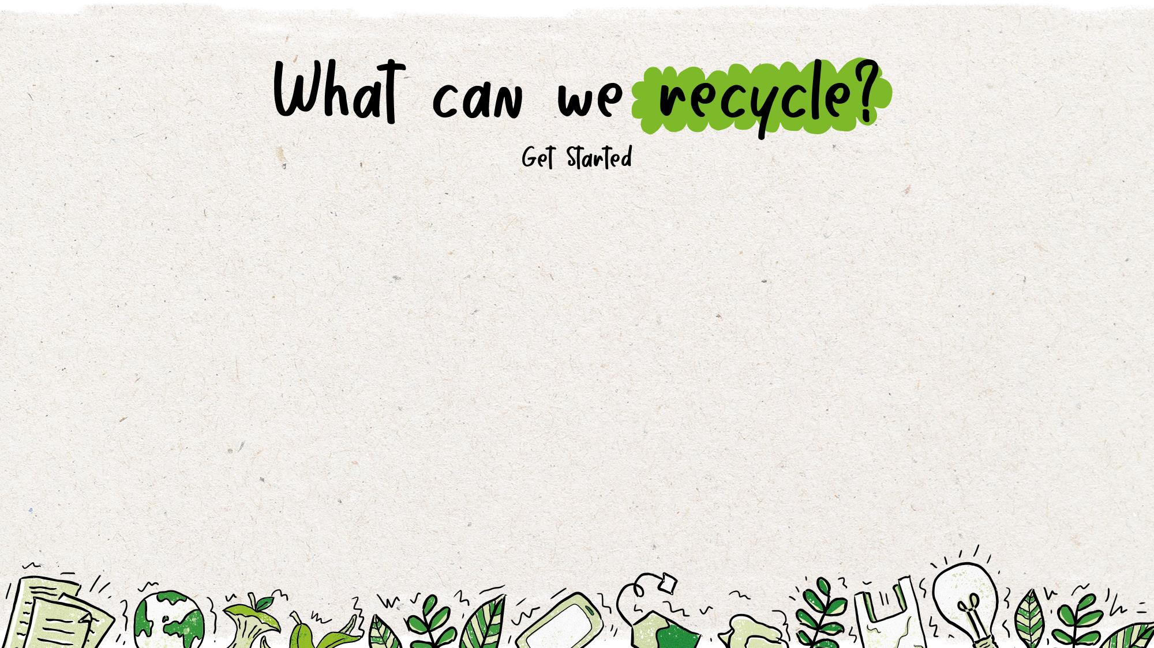
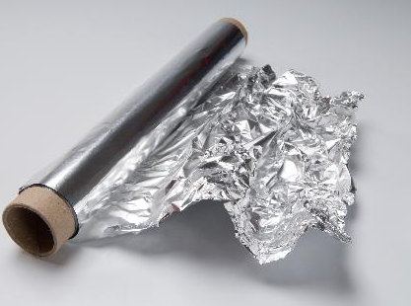
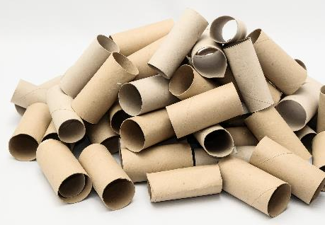
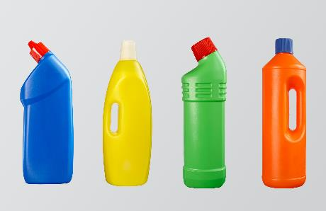
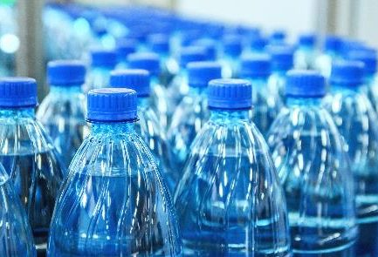
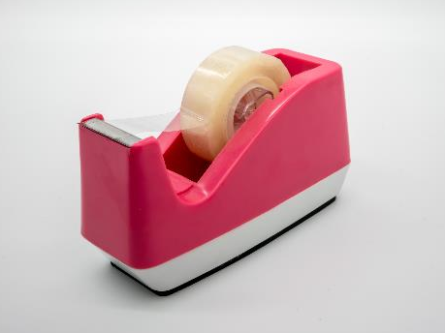

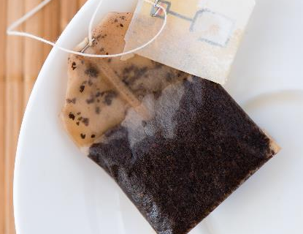

Notes:
Delivery notes
EXTENDED VERSION
Starter: Can these items be recycled? (5 minutes)
Review/refresh pupils’ knowledge of recycling with this optional active starter.
Please feel free to swap images to review particular examples if you have identified any common misconceptions in your class during the Join the Action Pack lesson.
Click to reveal the items one by one.
Ask pupils to stand up and put their arms in the air/stretch as high as the can if the item can be recycled and stay sitting down/squat down if it cannot.
If an item should go in the food waste bin ask pupils to put their hands on their head.
Answers:
Plastic bottles – yes, widely recycled
Aluminium Foil – yes, widely recycled
Sellotape – not recyclable
Cardboard loo roll – recyclable
Glass jar – recyclable
Plastic cling film – not widely recycled at home (although is accepted at carrier bag collection points)
Tea bags – compostable/food waste
Paper (coffee) cups – not widely recyclable. The plastic coating inside the cup is very hard to separate from the paper cup itself, which makes it hard to recycle as either plastic or paper.

Slide 9
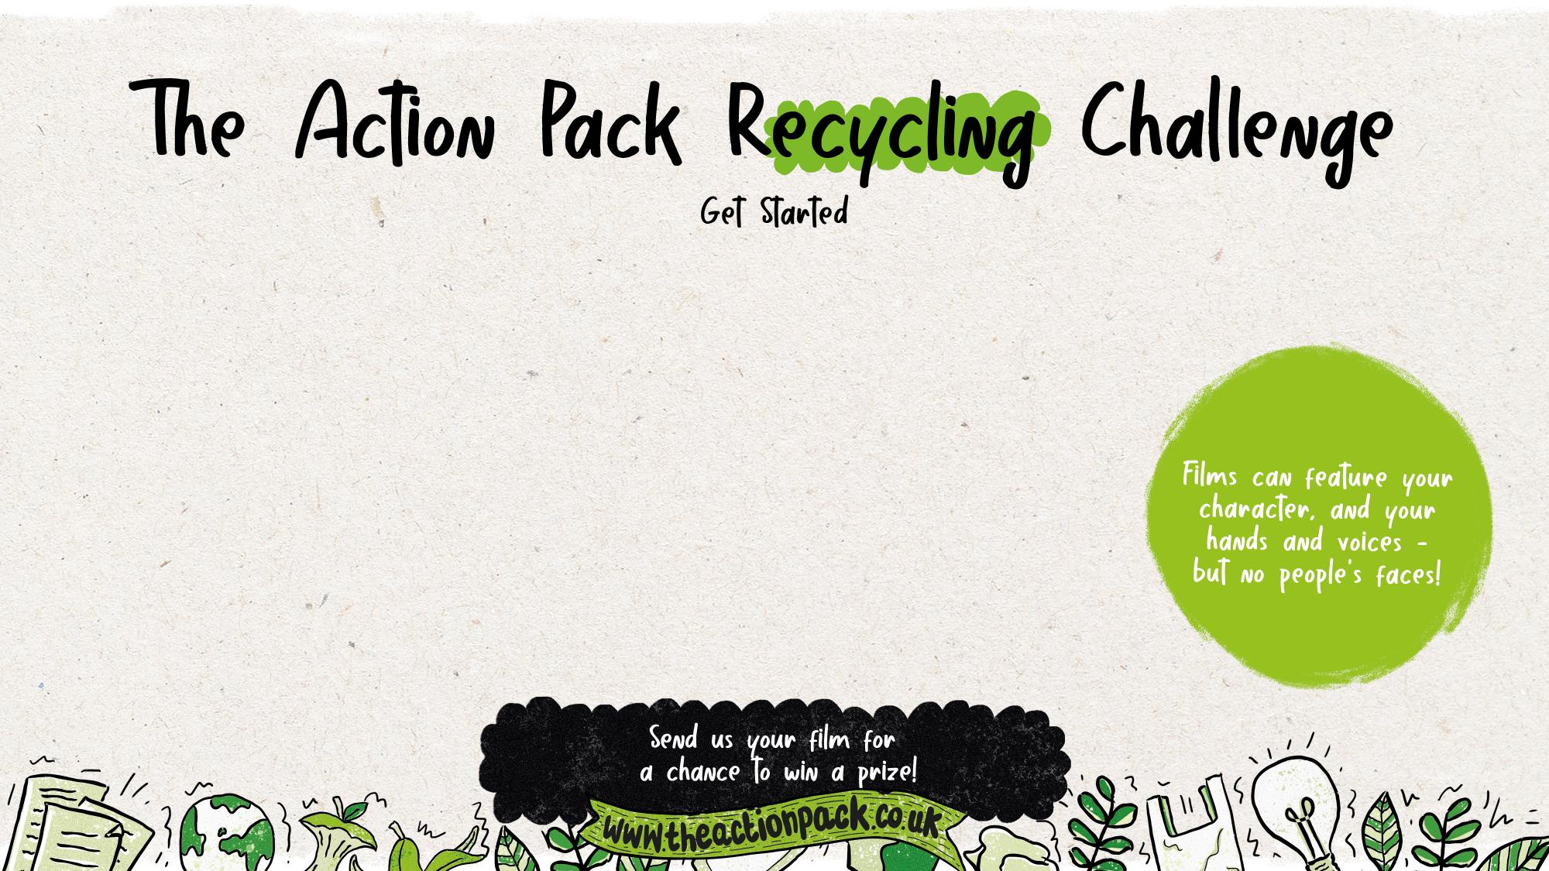
Your mission: Create a memorable animal character out of recyclable
materials and feature them in a film or play to help others to recycle more,
and recycle better
Task 1: Create your character – use recyclable materials to design and make your own animal recycling superstar
Task 2: Create your script – personalise our script, or get creative and write your own
Task 3: Shoot your film – lights, camera, action pack! Put yourself in the director’s chair and make your story come to life
Task 4: Tell the world – join Action Pack members up and down the country by sharing your work with your school, your family, your wider community – and with Recycle Now, for a chance to win a prize!
Notes:
Delivery notes
The Action Pack Recycling Challenge (5 minutes)
Introduce pupils to the Action Pack Recycling Challenge, running through the information on the slide.
Explain that in this lesson pupils are going to create a film or play to help others in your community to recycle more, and recycle better.
Once they’ve created an performed their story they can upload their film, or photos of the puppet play in action, to the Action Pack website to be in with a chance of winning a prize!
Please note that films uploaded to the Action Pack site should feature pupils’ artwork (i.e. their recycled puppets), but not their faces.

Slide 10
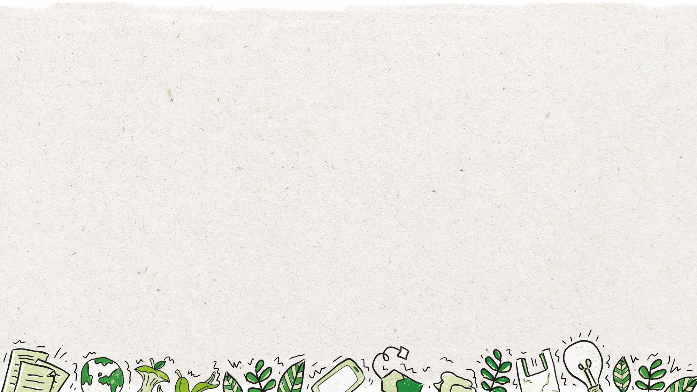

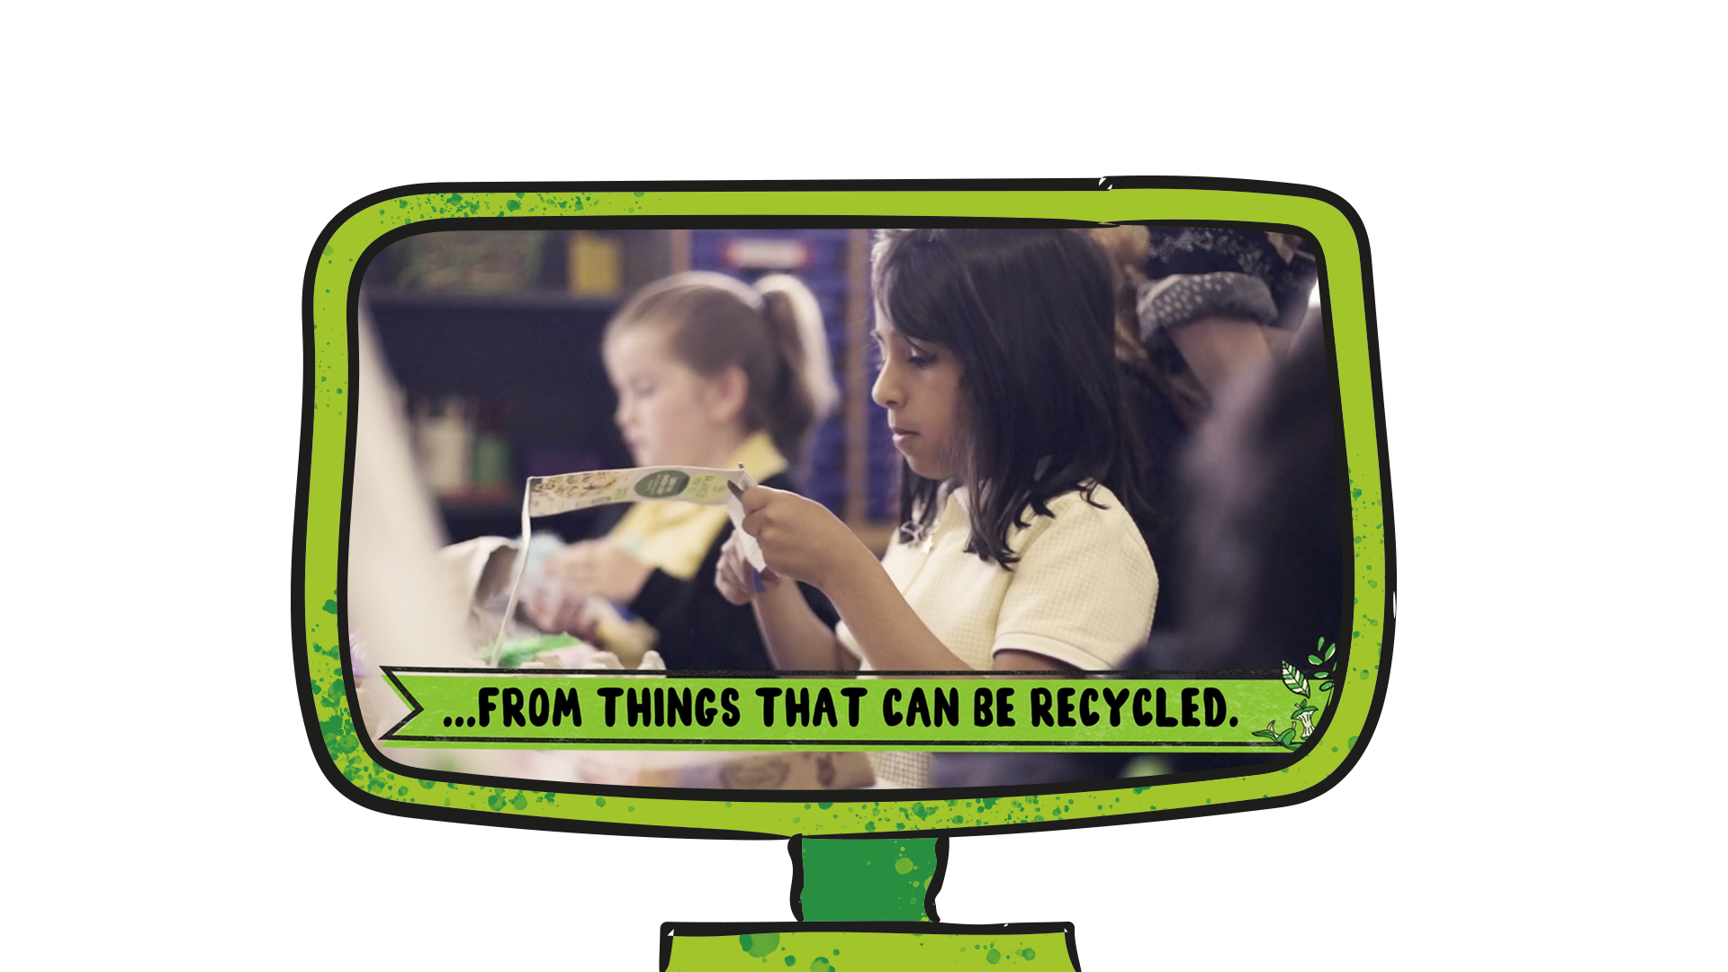

Notes:
Delivery notes – Skip this slide if you have completed this activity in a previous lesson
Get inspired film and discussion (5 minutes)
Watch the Action Pack video again and discuss the following questions:
What materials do the Action Pack use to create their characters?
What facts do you hear about recycling?
What effect did the Action Pack film have on you?
What was the main message in the film?
Did the film inspire you to take action? How did it do this?

Slide 11



Can I make a film or show to help others recycle more and better?
understand and employ personification to create my own animal character
use recyclable or reusable materials to design and build an animal character / puppet
identify and understand the key features in a script
understand and explain to others what can be recycled in my area
use facts and figures to support my message and grab my audience's attention
(optional) create a fun, creative and original film/show that will inspire others to recycle both more often and better.
Notes:
Delivery notes
Learning aim and success criteria (1 minute)
Introduce the learning aim.
Reinforce that pupils shows should not just encourage others to recycle not only more often but better e.g. thinking about what problems/mistakes their audience might make when recycling e.g. not remembering to rinse their tins or plastic bottles, mixing recyclable and non-recyclable materials, forgetting to recycle from the bathroom etc.

Slide 12
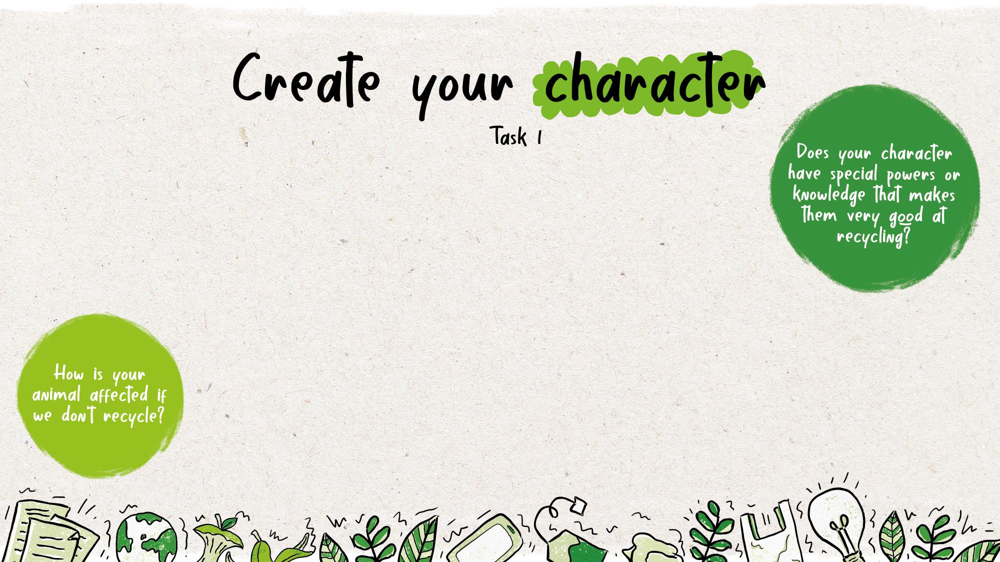
Task 1: Create your character – use recyclable materials to design and make your own animal recycling superstar
Remember: your character should be:
an animal or creature (this can be any animal, from the sea, land, or sky!)
made of recyclable or reusable materials
memorable – what will make your character stand out to people who watch your show or film? What makes them different from other characters?
passionate about recycling and ready to inspire others to recycle more and better!
Notes:
Delivery notes
SHORT VERSION
Create your character (5 minutes)
Run through this slide.
EXTENDED VERSION
Create your character (10 minutes)
Ask pupils (working independently or with a partner) to use the My character activity sheet (slide 21) to think about their character.
Once pupils have had time to complete their activity sheet/discuss their characters select a couple of pupils to present their ideas.
Why have you chosen that animal?
What is your character’s most important character trait?
Why does your character want more people to recycle?
Please note: We suggest pupils’ character’s should be an animal to help inspire pupils and reinforce the impact recycling can have on the natural world. However, we do encourage creativity, so entries that are mystical creatures/original creations are also allowed as long as they inspire others to recycle more and better!
Support: highlight the My character activity sheet word bank to help pupils design their character.
Challenge: when selecting key words to describe their characters, ask pupils to consider what characteristics they think are important for a character who wants to persuade others to recycle? (e.g. brave and outspoken to spread the word, helpful to inform and support others, or friendly and happy to help persuade?) Use the example animals on the Personification activity sheet (Slide 22) to start pupils thinking about the animal they could create and personify to be their character. Discuss with the class:
What animals or creatures could you create? (Think about the materials available, and what animals might help spread the world about recycling.)
Why have you chosen that animal/creature? (This could be for practical reasons, or initial story ideas e.g. a whale could be made from a plastic bottle with carboard fins, or a whale lives in the sea, which is where a lot of rubbish goes if we don’t recycle!)
What characteristics do you think that animal might have? (Make clear there are no right or wrong answers!)
Ask pupils to think of further animals they could create – e.g. what animals do they think would be most affected if people don’t recycle?

Slide 13
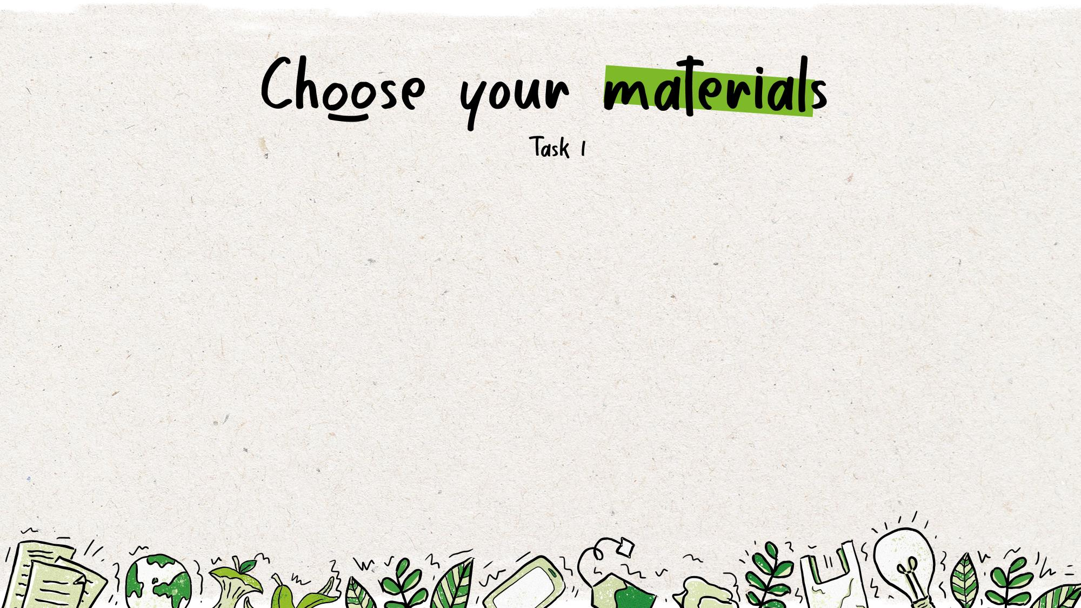
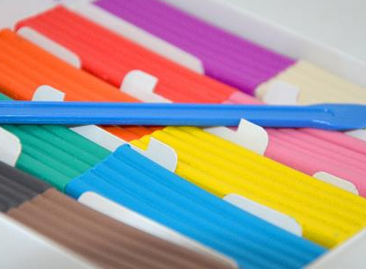

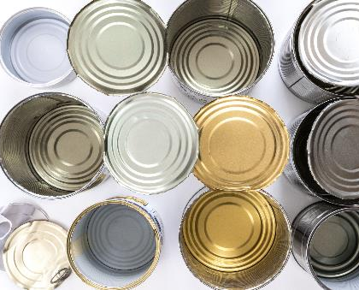

Notes:
Delivery notes
SHORT VERSION
Choose your materials (5 minutes)
Run through this slide.
EXTENDED VERSION
Choose your materials (1 minute)
Use the examples of the slides and/or display the items you have prepared to help inspire pupils. (Please feel free to delete/swap images to represent the materials available.)
Discuss with the class.
What materials could you use to create your character?
Why is it important to make sure our characters are made from recyclable/reusable materials?
Support: help pupils to identify each of the items in the images on the slide.
Challenge: ask pupils to add their own suggestions to the materials. Add non-recyclable materials to the slide to ask pupils to spot the materials they should avoid.
As an alternative to junk models (if material/time is scarce), pupils can be asked to create lollipop stick puppets.
Ask pupils to draw and colour in their character (alternatively simply draw outlines to create shadow puppets!)
Cut out the illustrations and stick to card.
Stick the card shape to a lollipop stick!
Perform your Eco Show and create a film/take a picture to upload to the Action Pack website!

Slide 14
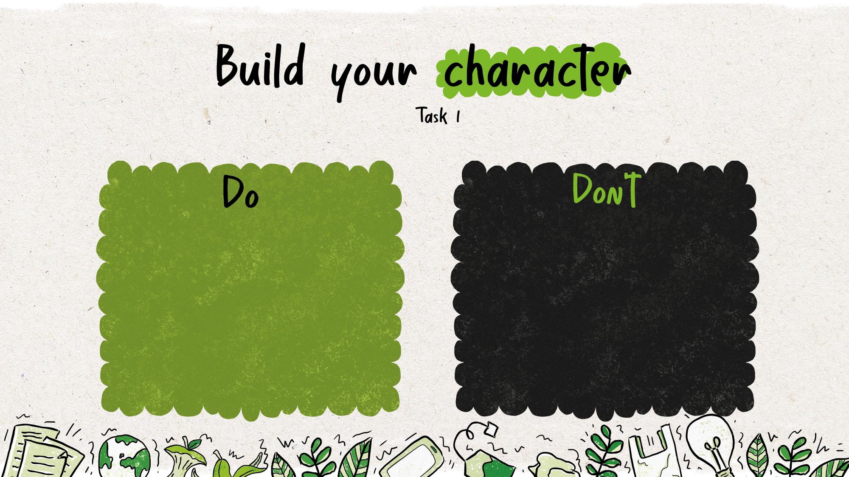
Put your Eco Show’s message into practice by making sure your character puppet is eco-friendly!
Check all the materials you use can be recycled in your area
Use butterfly clips, bulldog clips or sticky tack to build your model.
Take care cutting out any shapes to make sure you don’t waste materials.
Decorate your model with non-recyclable materials like glitter, glue, stickers, tissues, cotton wool or foil wrapping paper (remember the scrunch test)!
Glue/combine your materials together so they can’t be taken apart again. (Remember it’s harder to recycle objects made of lots of different materials.)
Use materials that aren’t widely recycled, such as plastic sticky tape!
Notes:
Delivery notes
SHORT VERSION
Build your character (15-20 minutes)
Run through this slide, and give your pupils time to create their characters.
EXTENDED VERSION
Build your character (1 minute)
Now pupils have decided on their character’s name, animal and characteristics, it’s time to build their models. Introduce the Action Pack’s modelling dos and don’ts to make sure all pupils’ character puppets are eco-friendly. Keep these on display as pupils are creating their models.
Support: guide pupils through each of the dos and don’ts. Give each group a limited number of materials with which to create their model.
Challenge: ask pupils for their own ideas before revealing the list – how can they make sure their model is eco-friendly apart from using recyclable/reusable materials? Use the following questions to guide discussions.
What should you do when you no longer want to keep their model?
What should you use to attach modelling materials together?
How should you decorate their model?
Building
Ask pupils to build their characters! Ask pupils/pairs to work on their own characters or divide pupils into small groups to select one or two of their characters to build together. Give pupils a clear time limit for working on their models, e.g. 15–20 minutes for a single session or 20–25 minutes if running across to sessions. (If running this activity over two sessions on different days, pupils can also be given the opportunity to complete their models at home.)
Reflection (if running as two sessions)
When time is up ask selected pupils/pairs to introduce their characters. What is their name? What are their characteristics? What did they use to make them? Draw out characteristics shared by different pupils characters and encourage pupils to reflect on how these will help the character spread their message.
Further information
For details of what can be recycled in your area, use Recycle Now’s recycling locator: www.recyclenow.com/local-recycling
Remind pupils of the coffee cup from the starter – this can’t be widely recycled because the plastic and paper is hard to separate, so avoid combining your materials in a permanent/hard to undo fashion, instead use clips or tak to create models, or create interlocking slits in cardboard
Encourage pupils to be efficient with cutting – even if you can recycle the materials it’s could to reuse as much as possible first!
Ask pupils to think carefully about how they decorate their characters – for example if using shiny paper/wrapping paper a good test of whether it is recyclable or not is whether the paper scrunches. If it scrunches in a ball it is recyclable, if not it may have to go in the bin! Watch this video for more information: www.recyclenow.com/what-to-do-with/wrapping-paper-1

Slide 15
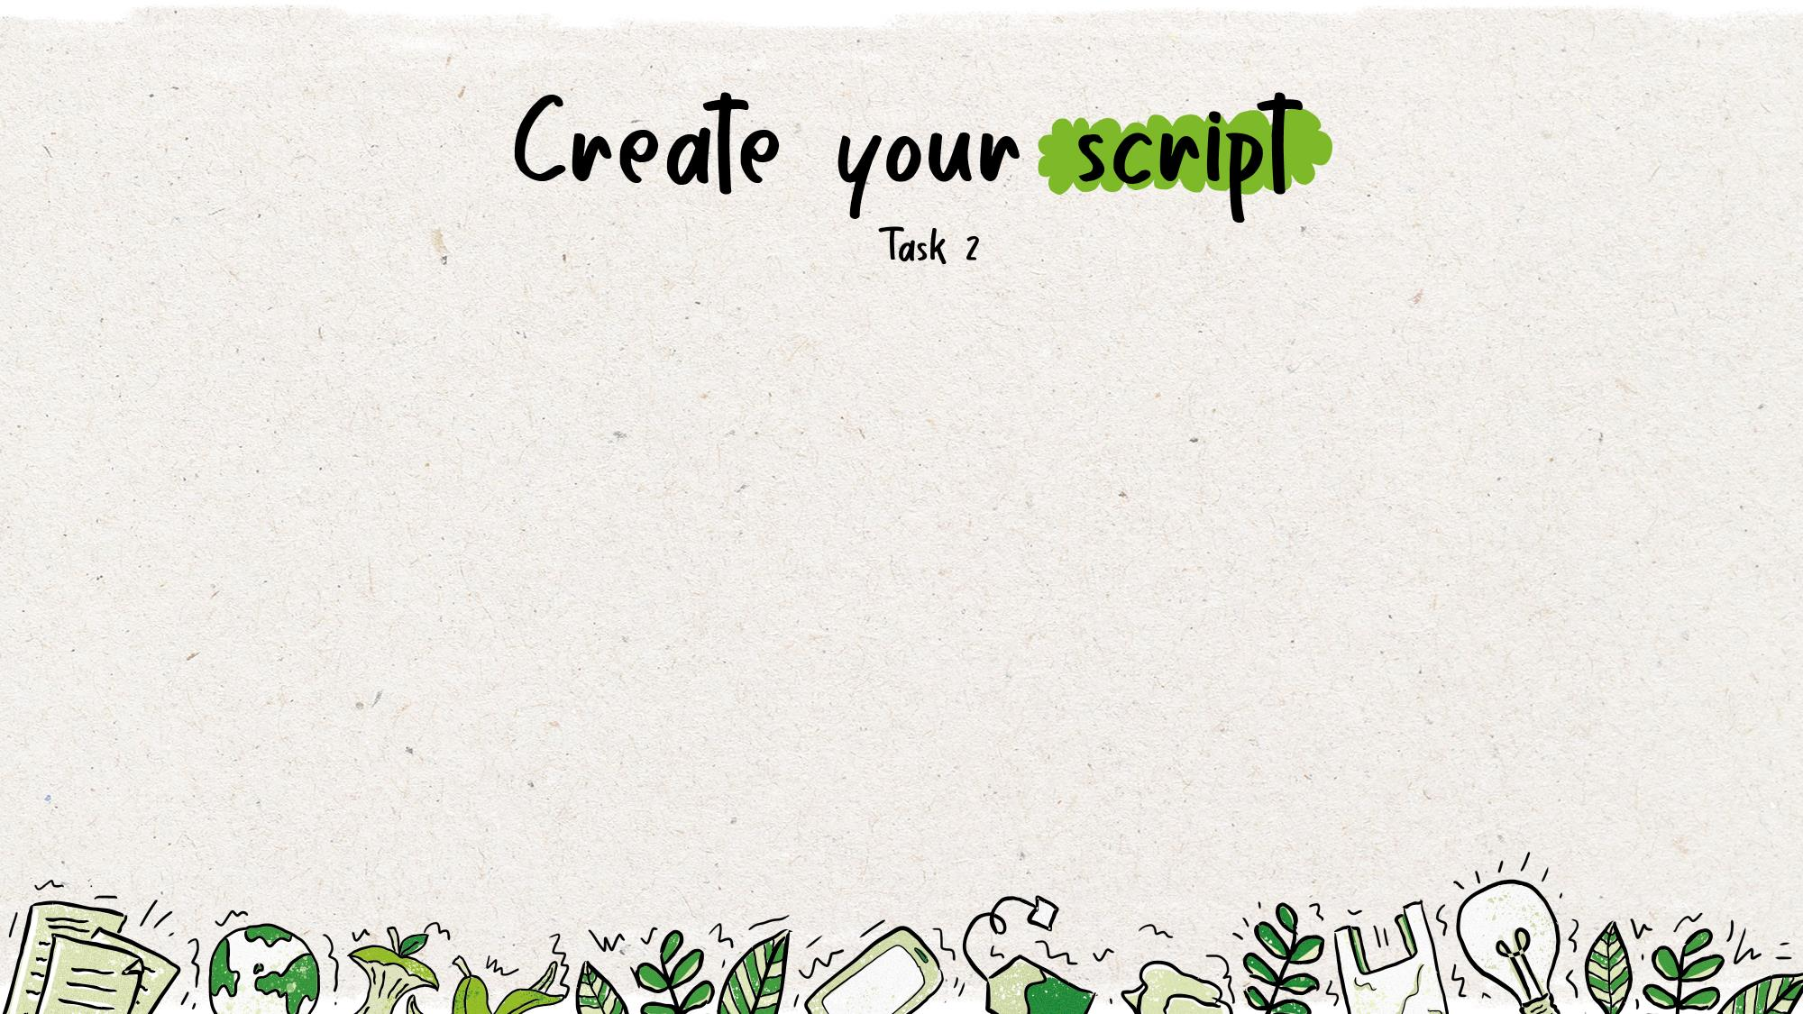
Task 2: Create your script – personalise our script, or get creative and write your own
Your script should:
inform others about what can be recycled in your area
inspire you audience to recycle more and better
be formatted as a script with dialogue and stage directions
star one (or more) of your characters!
Notes:
Delivery notes
Introduce pupils to their second Action Pack Task – to create or adapt a script that will star their character and persuade others to recycle more and better. Use Recycle Now’s recycling locator to adapt/help pupils adapt our Eco Show Example Script for your area and your pupils character (www.recyclenow.com/local-recycling) or use the following slides and our Eco Show Storyboard activity sheet to guide your pupils in creating their own script.

Slide 16
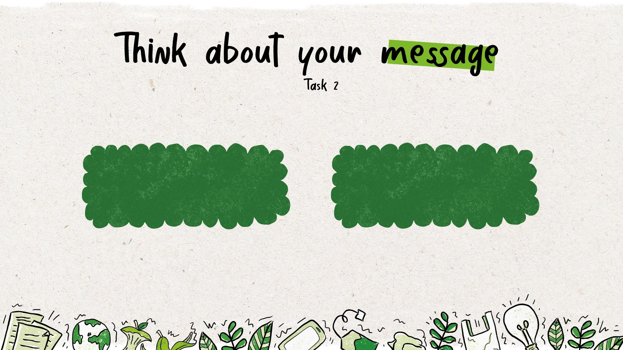
It is important to think about your main message:
Don’t try to say too much at once – choose one or two simple main messages to include in your script
Support your message with interesting stats and facts
Notes:
Delivery notes
Divide pupils into small groups (at least three) and ask them to discuss and decide upon their scripts main audience, message, characters and setting and complete the My Eco Show Script Planner activity sheet.
Audience – e.g. What goes in each bin? What can be recycled from each room at home? Common mistakes?
Message – e.g. It’s easy to recycle! Join the action pack!
Character – e.g. Is your character affected if we don’t recycle, do they have special powers or knowledge that make them very good at recycling?
Setting – e.g. In a house (showing what you can recycle in different rooms?), in a recycling plant, in your characters home, in more than one location?
Support: read the Eco Show Example Script together as a class, and then ask groups to identify the key message of the script and how the characters are used to grab the audience attention and inspire others.
Pupils can also use their completed My character activity sheet to help them think about their characters and the myth buster information from the Join the Action Pack presentation to build on their help discussions.

Slide 17
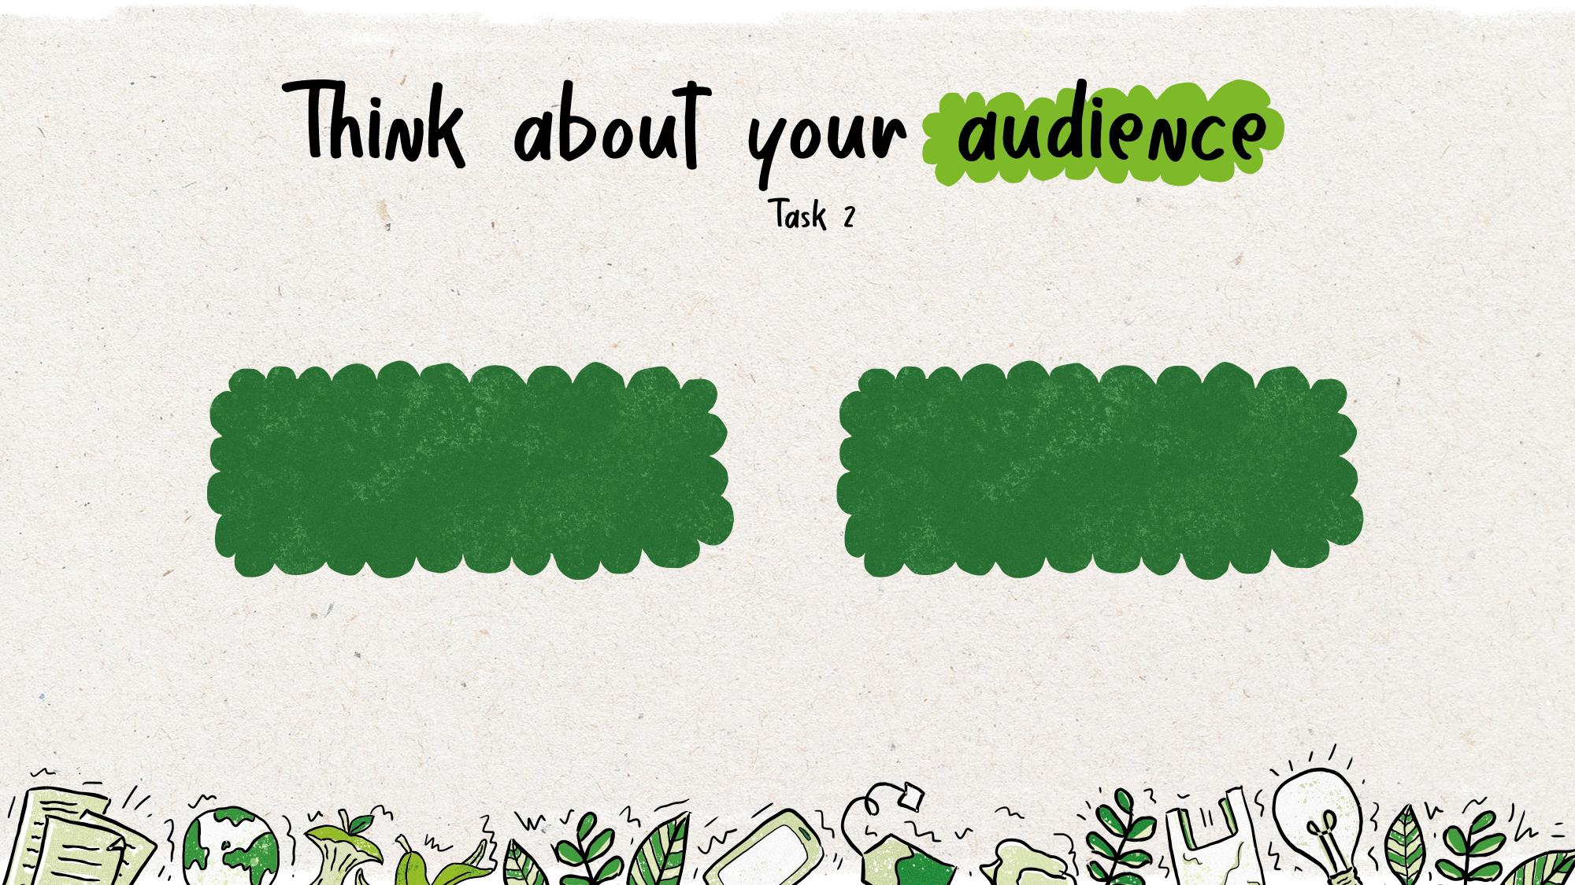
Before you write your script, you should also consider
Who is your main audience?
What is most important for them to know?
Notes:
Delivery notes
Encourage pupils to think about their audience (e.g. their families) and recycling:
What do they do well already?
What don’t they do so well?
What might they not know?
Refer to the results of the Home recycling survey (if completed) or their own ideas.
Optional: time permitting, run discussions as an active brainstorm.
Work through the questions one by one taking suggestions at the front and adding them to three large A3/A2 pieces of paper.
Divide the pieces of paper around the room
Ask pupils to move around the room and write down as many answers as possible to each question in 1 minutes (divide into two groups if a large class, or give each pupils a stack of post its)
Repeat the activity, but ask pupils to now think specifically about particular audiences/groups of people such as: older people (e.g. grandparents), parents/guardians, older brothers/sisters, teachers, neighbours (if possible use different colour pens/post its for each group)
Once finished give pupils two minutes to walk around and read what other pupils have written and add a tick next to ideas/questions they think are the most important
Collect in the sheets and share the most ticked ideas/questions with the class
Ask pupils to discuss these ideas with a partner – how could they answer these questions/use these ideas in their film? Select pairs to feedback their initial ideas.

Slide 18
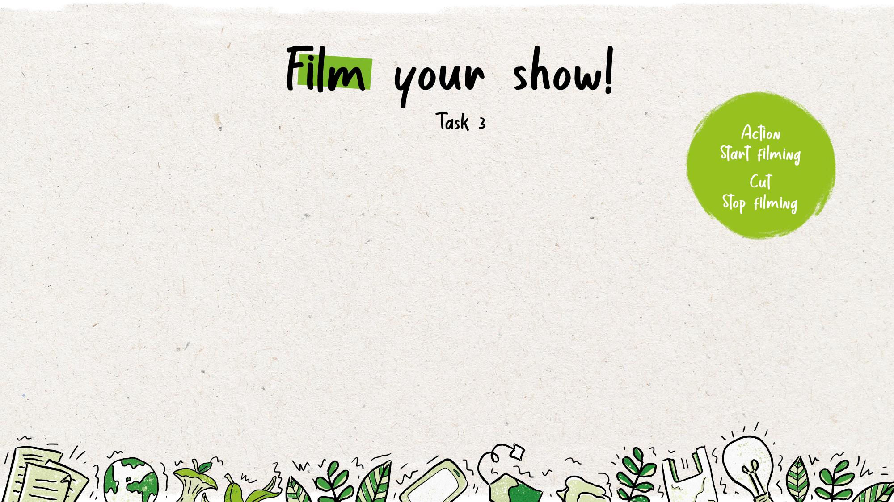
Task 3: Shoot your film/stage your play – lights, camera,
action pack! Put yourself in the director’s chair and make your
story come to life
Your group should:
assign roles – you will need a camera operator, a director and puppeteers
plan the best shots for your film – film in portrait, not landscape and make sure you show your puppets, but not the puppeteers
rehearse your script – make sure everyone knows what to do when the director says action
hold the camera steady – can the camera operator rest the camera on a flat surface while filming?
test your camera and sound before filming – is everything working properly?
Notes:
Delivery notes
Prompt pupils to film their show, so they can share their work with a wider audience (if not possible, they can perform their show in an assembly for their peers and teachers, or even invite parents along, to another class, or at another school event).
Ensure pupils understand their roles
Director – to manage the filming, everyone should listen to them when they call action and cut! The director should discuss the script with all members of the team and make sure everyone knows where to stand/what to say.
Camera operator – to test the equipment, hold the camera and film the action!
Puppeteers – the actors! These pupils must hold and operate the puppets and perform the script
Please ensure that filming and photography uploaded to the Action Pack website includes pupils work, but not their faces.

Slide 19
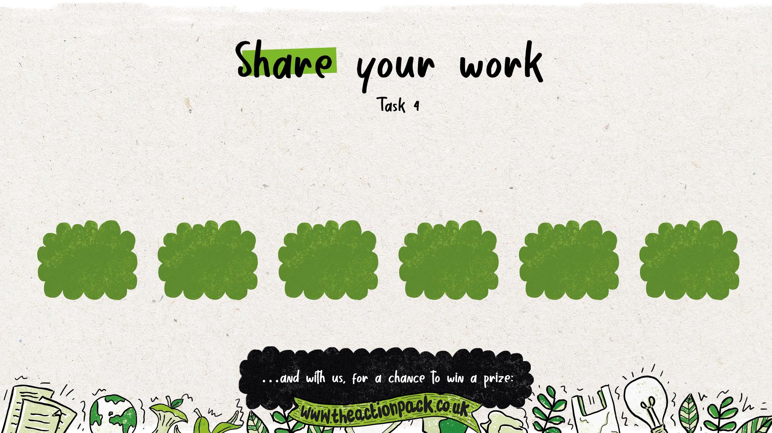
Task 4: Tell the world – join Action Pack members up and down the country by sharing your work with your school, your family, your wider community – and with Recycle Now, for a chance to win a prize!
Share your work through…
school social media challenges
the school newsletter
a parents’ assembly
parents’ Whatsapp group
the local council
the local press
Notes:
Delivery notes
Share your pupils work with the school and wider community – the Action Pack’s Eco Shows.
Post your film links on class WhatsApp groups or school social media channels
Put the film links in the school newsletter. Kids could take over the school newsletter, featuring their film and other work around recycling or eco topics.
Invite parents in to school to watch your show live.
Share your research findings with your parents so they know what not to buy!
Send your films to the local council or local press.
And share your films with us to be in with a chance of winning a prize!
For more information and full terms and conditions please see: URL

Slide 20
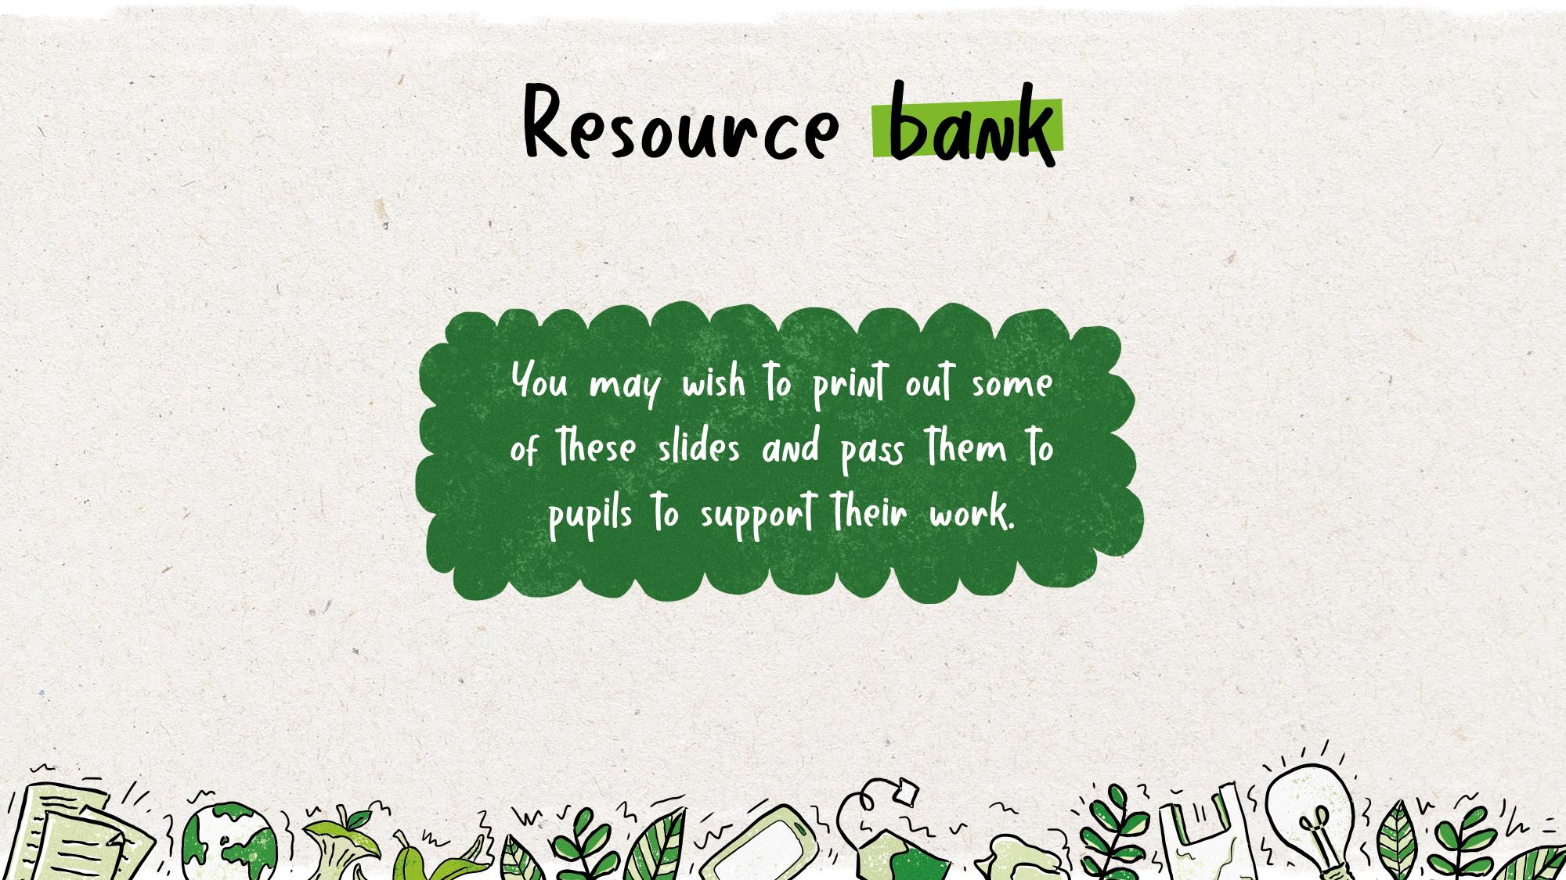

Slide 21




Add notes to answer the questions below to start creating your Action Pack character
What animal will inspire your character?
What is your character’s name?
Draw/sketch your character.
Where do they live?
How old is your character?
What is your character like? Pick three words to describe their personality.
What does your character like to do? Name two activities.
Why is recycling important to your Eco Guardian? Write three reasons
Word bank Places - setting
sea * ocean * forest * garden * nest * mountain * recycling bin * shed * city * hill * nest * wood
Verbs - doing words
walk * run * smile * play * recycle * sort * rinse * clean * help * swim * fly * laugh * sing *
Adjectives - describing personality
loud * quiet * shy * outgoing * energetic * lazy * happy * sad * outspoken * clever * brave * friendly * funny * caring * sensible * cool * calm * adventures * awkward * patient * helpful

Slide 22
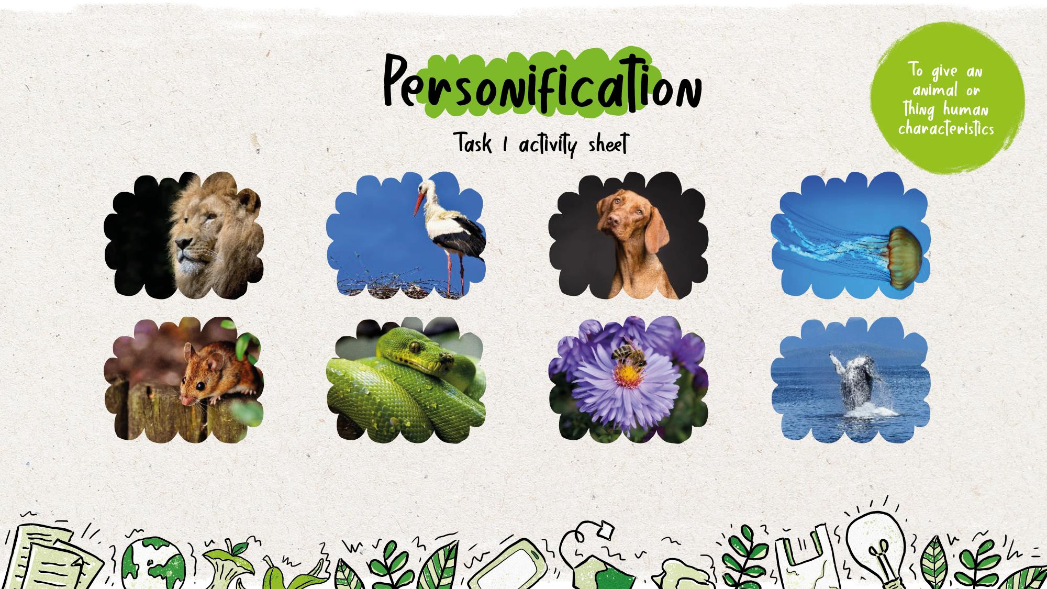
Which animal might be…
loud * proud * quiet * shy * outgoing * energetic * happy * outspoken * clever * brave * busy * helpful

Slide 23
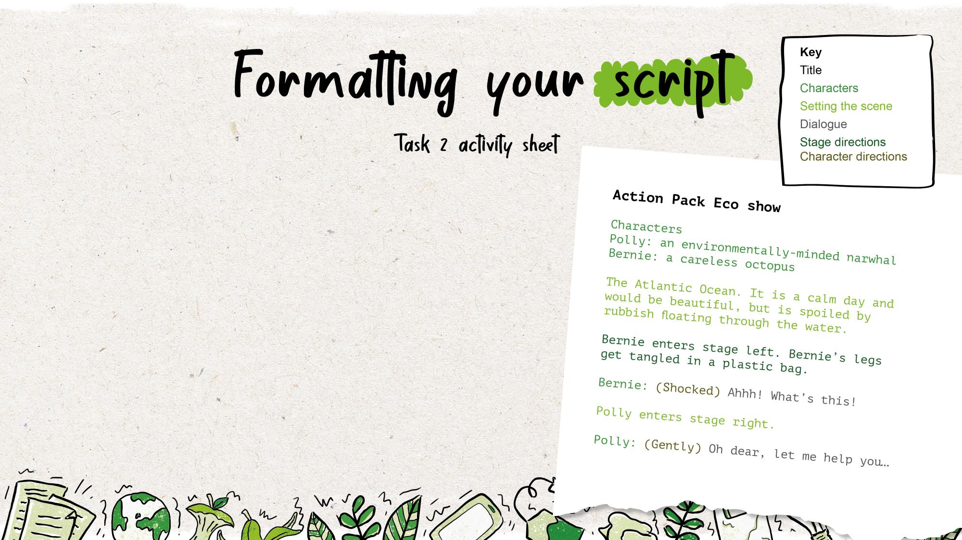
Scripts always have a clear structure, with stage directions, characters and dialogue clearly laid out. A script should include:
a character list (to introduce your characters)
an introduction to set the scene (explain where your characters are)
dialogue (what the characters say) introduced with the character name followed by a colon: no ‘speech marks’ are needed
stage directions (instructions for how the actors should move)
character directions (instructions telling an actor how to perform their dialogue).
Notes:
Delivery notes
Ask pupils to work in their groups to start creating/adapting their scripts. Remind them of the layout of a script (slide 25 can be displayed as pupils work, or give out the Top Tips for Writing a Script information sheet) and to think about how they can use literary techniques to make their script persuasive. If resources are not available for filming, pupils can perform their Eco Show as a play and/or use the Storyboard Template activity sheet to depict their planned film.
Support: ask pupils to adapt the Eco Show Example Script with their own characters and information about recycling in your local area. Some pupils may prefer to use the Storyboard Template activity sheet to create their script/plan their film.
Challenge: ask pupils to create their own script using the resources provided. Pupils can complete the Storyboard Template activity sheet to plan their film before shooting.

Slide 24



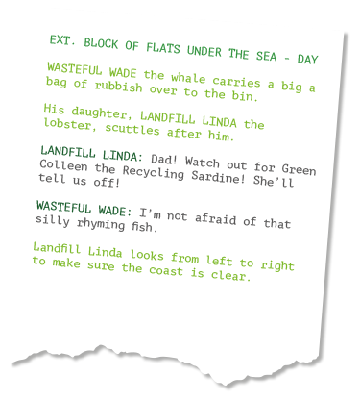



Title: give your film a title.
Make it short and snappy!
Setting: introduce your setting with a short paragraph.
Where are your characters?
What is the time?
What can they see?
Characters: Write two sentences
to introduce your character(s).
e.g. Bernie is a clever and outspoken whale. He loves swimming, but is worried about rubbish in the ocean.
Dialogue: write your character’s name before they speak.
If you want your character to pause in their speech, use an ellipse…
to mark the gap.
Stage directions: include information for your actors in brackets.
Use the present tense
Notes:
Delivery notes
Use the slide and/or the Eco Show Example Script to briefly introduce/review the main features and format of a script.

Slide 25


Your script should:
Inform others about what can be recycled in your area
Inspire your audience to recycle more and better
be formatted as a script with dialogue and stage directions
star one (or more) of your characters!
Use this planner to create your script.
Key characters
List your main character(s) below. Write a sentence to describe your character(s).
Film title:
Audience
Who is your main audience? (e.g parents/neighbours)
Write one thing your audience need to know about recycling to help them recycle more and better.
Setting
List your main character(s) below. Write a sentence to describe your character(s).
Main message
What is the main message of your film? Write one sentence / a catchy slogan to summarise / share your message.
Word bank
recycle * reuse * reduce * environment * earth * rinse * landfill * bin * waste * kitchen * bathroom
* living room * bedroom * paper * glass * tins * cans * cardboard * separate * simple * join * action pack * outgoing * happy * outspoken * clever * brave * friendly *

Slide 26
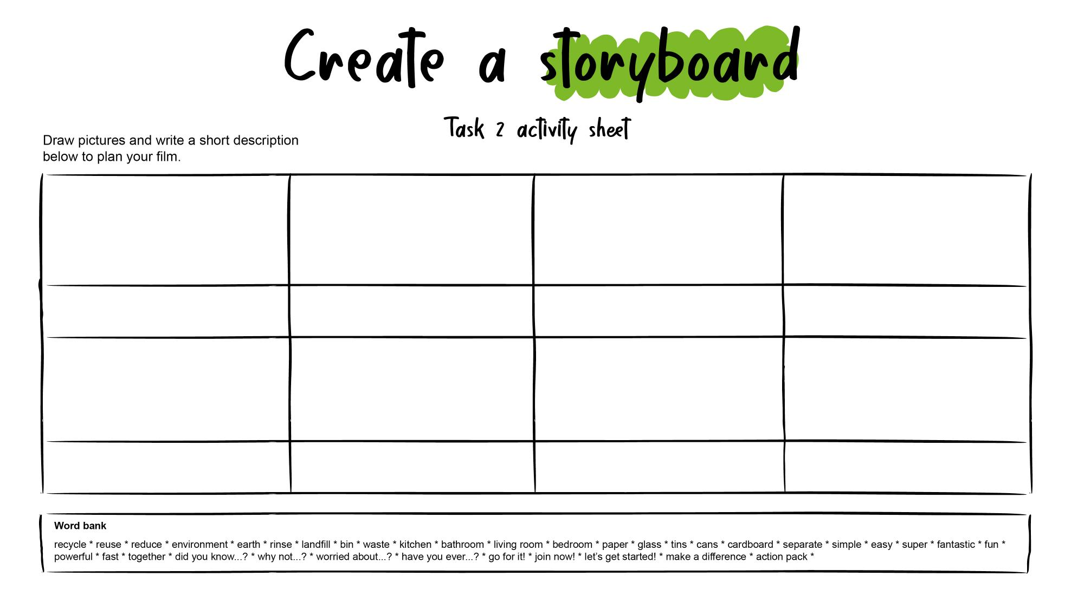
Notes:
Alternative for younger children

Slide 27
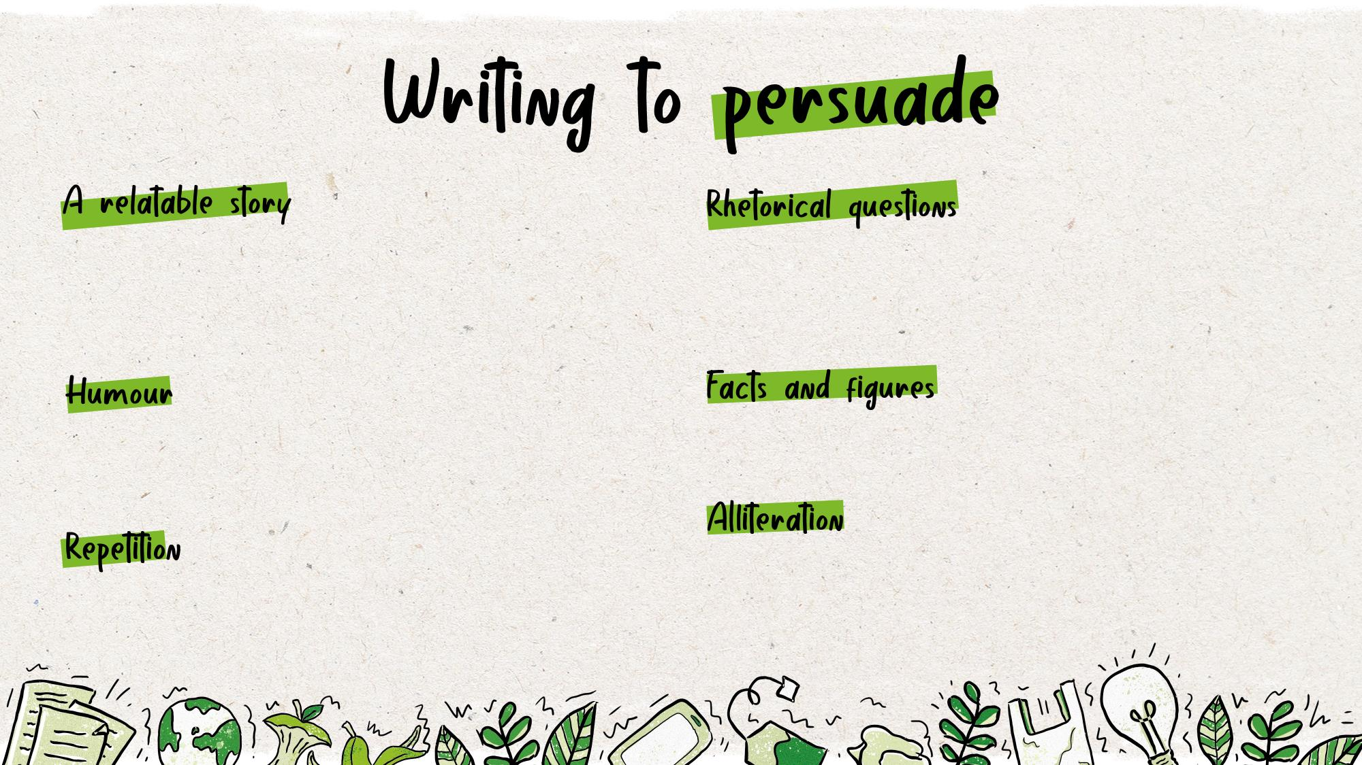
There are lots of different techniques to help you persuade an audience – could you include any of the ideas below in your script?
Task 2 activity sheet
Help your audience understand the issue through your characters e.g. how your Eco Guardian is affected when people don’t recycle, or how easy it is for your Eco Guardian to learn about recycling.
These are questions that don’t expect a response.
They can engage your audience and make them
think e.g. ‘can you recycle more?’
If something is funny, it will grab your audience’s attention and put them in a good mood, which may make them easier to persuade!
Back up your message.
This can help your audience remember your message e.g. reduce, reuse, recycle
Repeat your key message throughout your story to make sure it’s clear, can you think of a catchy slogan or rhyme you could use?

